Slide 1

Micro-Credit Defaulter
Submitted by:
NAGAPPAN KANNAPPAN

Slide 2
ACKNOWLEDGMENT
I would like to express my special thanks to Datatarained & FlipRobo who gave me this golden opportunity for this internship on the topic of Micro-Credit Defaulter. The sample data is provided to us from FlipRobo’s client database. Kaggle & Github are the websites which helped me in completing the project.

Slide 3
Business Problem
A Microfinance Institution (MFI) is an organization that offers financial services to low income populations. MFS becomes very useful when targeting especially the unbanked poor families living in remote areas with not much sources of income. The Microfinance services (MFS) provided by MFI are Group Loans, Agricultural Loans, Individual Business Loans and so on. Today, microfinance is widely accepted as a poverty-reduction tool, representing $70 billion in outstanding loans and a global outreach of 200 million clients.
In order to improve the selection of customers for the credit, the client wants some predictions that could help them in further investment and improvement in selection of customers. Here we need to build model which can be used to predict in terms of a probability for each loan transaction, whether the customer will be paying back the loaned amount within 5 days of insurance of loan.

Slide 4
Conceptual Background of the Domain Problem
Many microfinance institutions (MFI), experts and donors are supporting the idea of using mobile financial services (MFS) which they feel are more convenient and efficient, and cost saving, than the traditional high-touch model used since long for the purpose of delivering microfinance services. Though, the MFI industry is primarily focusing on low income families and are very useful in such areas, the implementation of MFS has been uneven with both significant challenges and successes. Here the client that is in Telecom Industry is a fixed wireless telecommunications network provider. They have launched various products and have developed its business and organization based on the budget operator model, offering better products at Lower Prices to all value conscious customers through a strategy of disruptive innovation that focuses on the subscriber. They understand the importance of communication and how it affects a person’s life, thus, focusing on providing their services and products to low income families and poor customers that can help them in the need of hour.
They are collaborating with an MFI to provide micro-credit on mobile balances to be paid back in 5 days. The Consumer is believed to be defaulter if he deviates from the path of paying back the loaned amount within the time duration of 5 days. For the loan amount of 5 (in Indonesian Rupiah), payback amount should be 6 (in Indonesian Rupiah), while, for the loan amount of 10 (in Indonesian Rupiah), the payback amount should be 12 (in Indonesian Rupiah).

Slide 5
Review of Literature
Microfinance is a banking service provided to unemployed or low-income individuals or groups who otherwise would have no other access to financial services. Microfinance allows people to take on reasonable small business loans safely, and in a manner that is consistent with ethical lending practices.

Slide 6
Motivation for the Problem Undertaken
With the help of this project deserved people will get loan more easily & quickly. Being a part of this project and reducing poverty is a proud feeling & motivation.

Slide 7
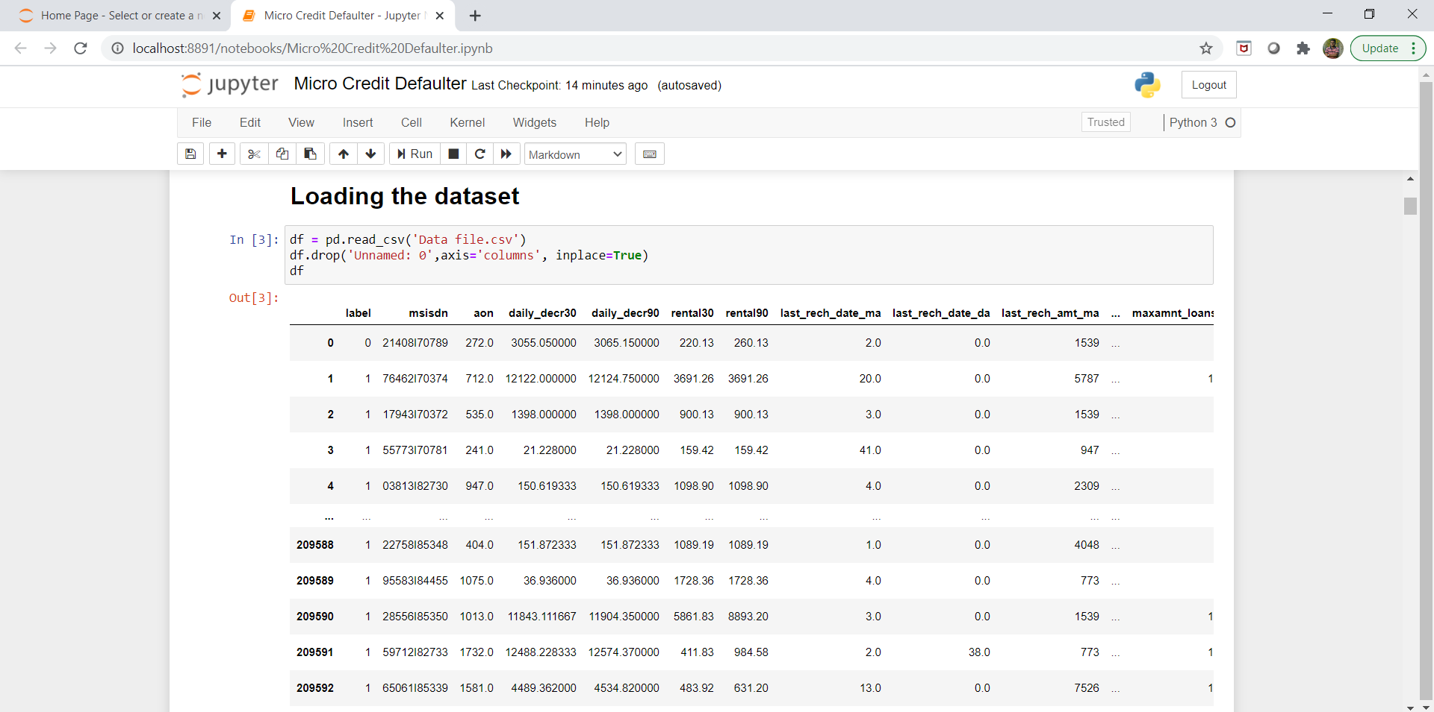
Data Sources and their formats
The sample data is provided to us from FlipRobo’s client database.

Slide 8
Mathematical/ Analytical Modelling of the Problem
In this case, Label ‘1’ indicates that the loan has been paid i.e. Non- defaulter, while, Label ‘0’ indicates that the loan has not been payed i.e. defaulter. In the provided dataset, our target variable "label" is a categorical with two categories: " defaulter " and " Non- defaulter ". Therefore we will be handling this modelling problem as classification.

Slide 9
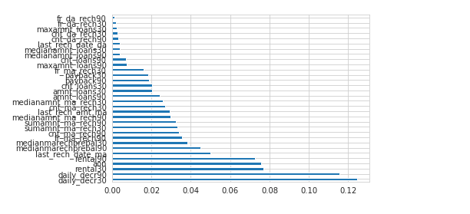
Data Pre-processing Done
Dropping unimportant columns.
Feature importance
Dropping less
important features.

Slide 10
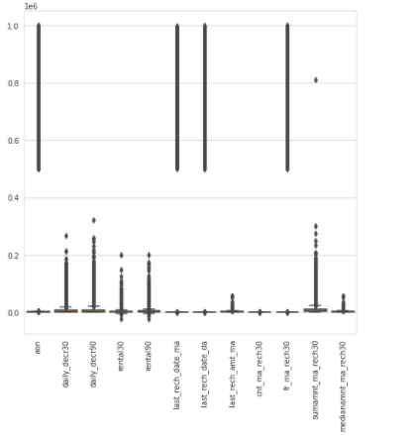
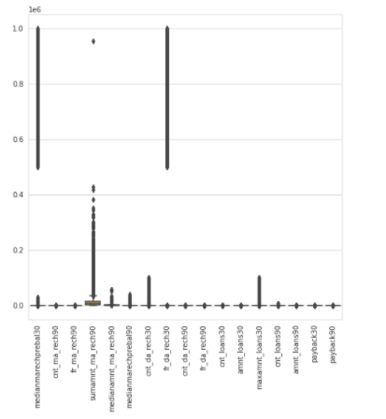
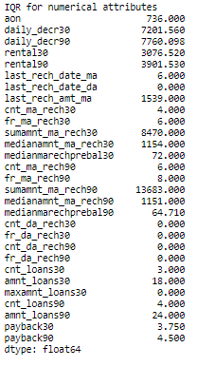
Outliers handing.

Slide 11
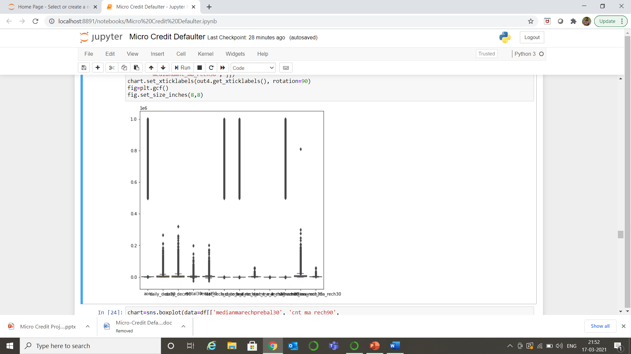
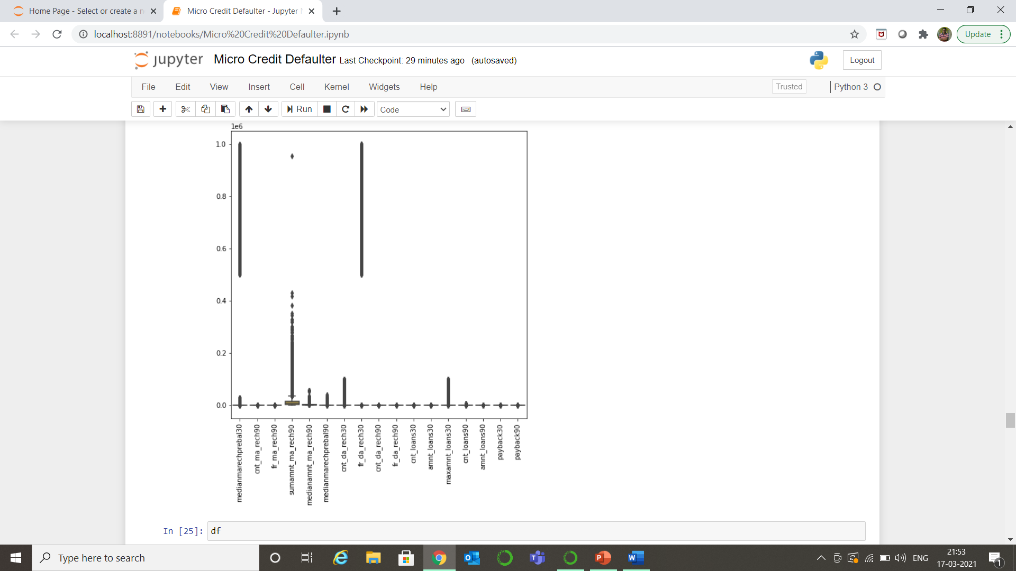
After processing the outliers.

Slide 12
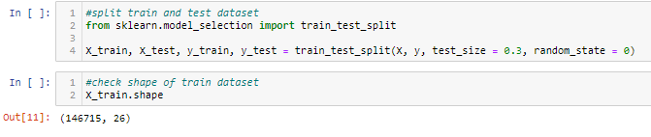
Imbalance dataset is normalized for final modeling.
After splitting the data for input and output standard scalar is applied to standardize the input data.
After train test split we apply all the classification algorithms with hyper tuning to find the best scoring one.

Slide 13
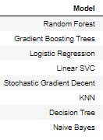
After applying all the above classification algorithms on the dataset we see that Gradient Boosting trees & Random Forest both fits the best for our objective.

Slide 14
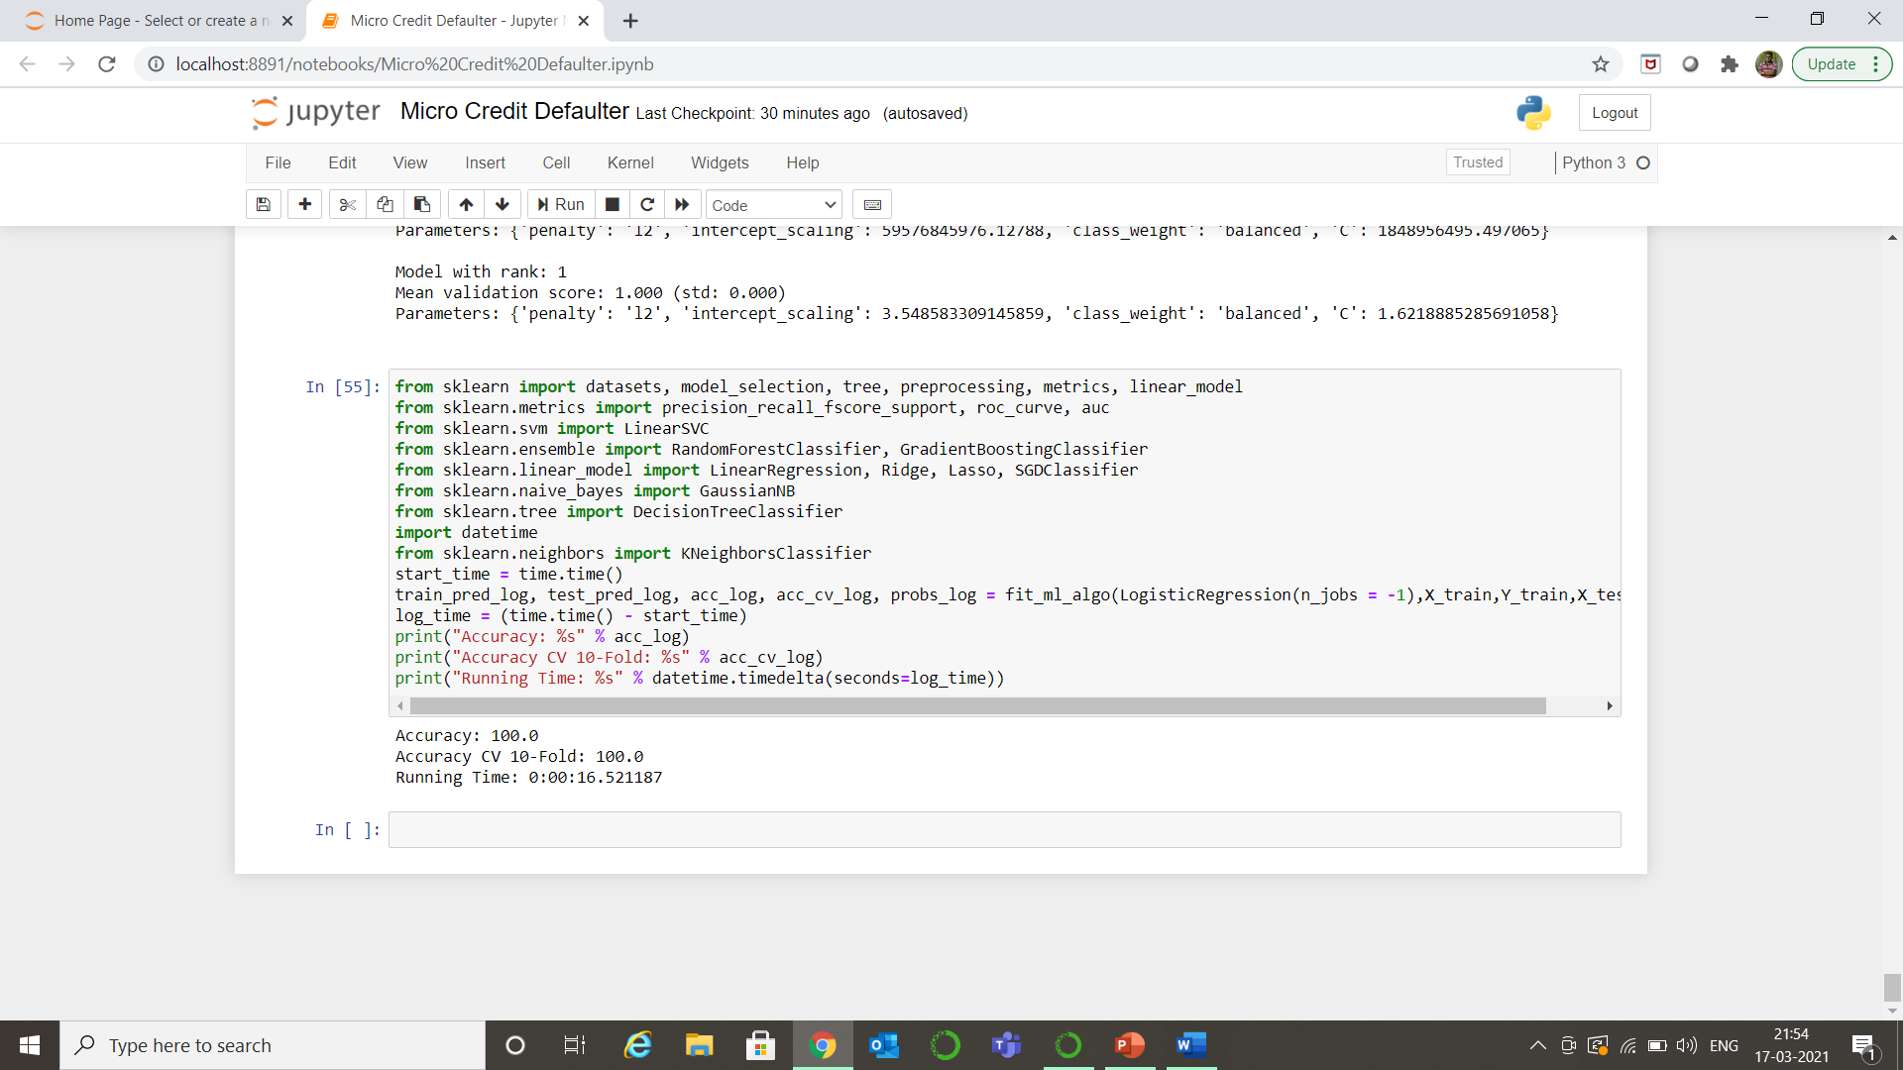
We will use Logistic Regression as our final model.
The final model is saved.
End.

